Slide 1

Java Introduction
Basic Syntax , I/O, Conditions, Loops and Debugging
Software University
Technical Trainers
Software University
https://softuni.bg

Slide 2
Table of Contents
Introduction and Basic Syntax
Comparison Operators
The if-else / switch-case Statement
Logical Operators
Loops
Debugging and Troubleshooting

Slide 3
Have a Question?
sli.do
#fund-java

Slide 4

Introduction and Basic Syntax

Slide 5
Java – Introduction
Java is modern, flexible, general-purpose programming language
Object-oriented by nature, statically-typed, compiled
In this course will use Java Development Kit (JDK) 13
static void main(String[] args) {
//Source Code
}
Program starting point

Slide 6
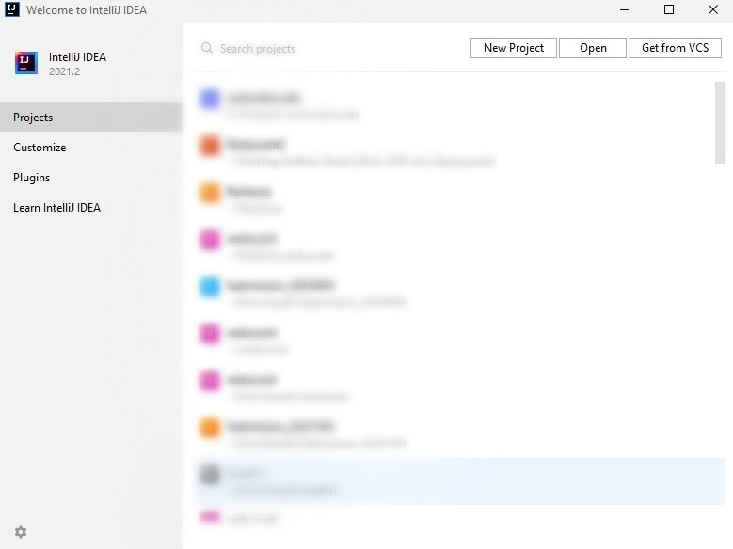
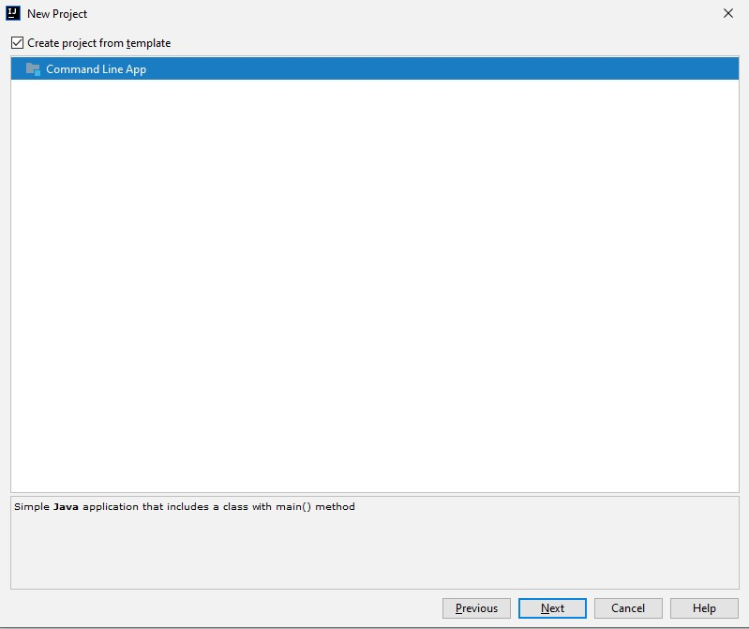
Using Intellij Idea
Intellij Idea is powerful IDE for Java and other languages
Create a project

Slide 7
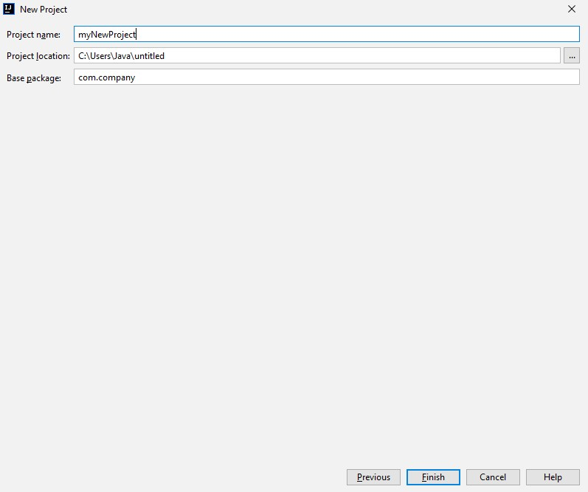
Using Intellij Idea

Slide 8
Declaring Variables
Defining and Initializing variables
Example:
{data type / var} {variable name} = {value};
Variable name
int number = 5;
Data type
Variable value

Slide 9

Console I/O
Reading from and Writing to the Console

Slide 10
Reading from the Console
We can read/write to the console, using the Scanner class
Import the java.util.Scanner class
Reading input from the console using
import java.util.Scanner;
…
Scanner sc = new Scanner(System.in);
String name = sc.nextLine();
Returns string

Slide 11
Converting Input from the Console
scanner.nextLine() returns a String
Convert the string to number by parsing:
import java.util.Scanner;
…
Scanner sc = new Scanner(System.in);
String name = sc.nextLine();
int age = Integer.parseInt(sc.nextLine());
double salary = Double.parseDouble(sc.nextLine());

Slide 12
Printing to the Console
We can print to the console, using the System class
Writing output to the console:
System.out.print()
System.out.println()
System.out.print("Name: ");
String name = scanner.nextLine();
System.out.println("Hi, " + name);
// Name: George
// Hi, George

Slide 13
Using Print Format
Using format to print at the console
Examples:
String name = "George";
int age = 5;
System.out.printf("Name: %s, Age: %d", name, age);
// Name: George, Age: 5
Placeholder %s stands for string and corresponds to name
Placeholder %d stands for integer number and corresponds to age

Slide 14
Formatting Numbers in Placeholders
D – format number to certain digits with leading zeros
F – format floating point number with certain digits after the decimal point
Examples:
int percentage = 55;
double grade = 5.5334;
System.out.printf("%03d", percentage); // 055
System.out.printf("%.2f", grade); // 5.53

Slide 15
Using String.format
Using String.format to create a string by pattern
Examples:
String name = "George";
int age = 5;
String result = String.format("Name: %s,
Age: %d", name, age);
System.out.println(result);
//Name: George, Age 5

Slide 16
Problem: Student Information
You will be given 3 input lines:
Student Name, Age and Average Grade
Print the input in the following format:
"Name: {name}, Age: {age}, Grade {grade}"
Format the grade to 2 decimal places
John
15
5.40
Name: John, Age: 15, Grade: 5.40
Check your solution here: https://judge.softuni.bg/Contests/1190/

Slide 17
Solution: Student Information
import java.util.Scanner;
…
Scanner sc = new Scanner(System.in);
String name = sc.nextLine();
int age = Integer.parseInt(sc.nextLine());
double grade = Double.parseDouble(sc.nextLine());
System.out.printf("Name: %s, Age: %d, Grade: %.2f",
name, age, grade);

Slide 18
Comparison Operators
==

Slide 19
Comparison Operators
Operator | Notation in Java
Equals | ==
Not Equals | !=
Greater Than | >
Greater Than or Equals | >=
Less Than | <
Less Than or Equals | <=

Slide 20
Comparing Numbers
Values can be compared:
int a = 5;
int b = 10;
System.out.println(a < b);
System.out.println(a > 0);
System.out.println(a > 100);
System.out.println(a < a);
System.out.println(a <= 5);
System.out.println(b == 2 * a);
// true
// true
// false
// false
// true
// true

Slide 21
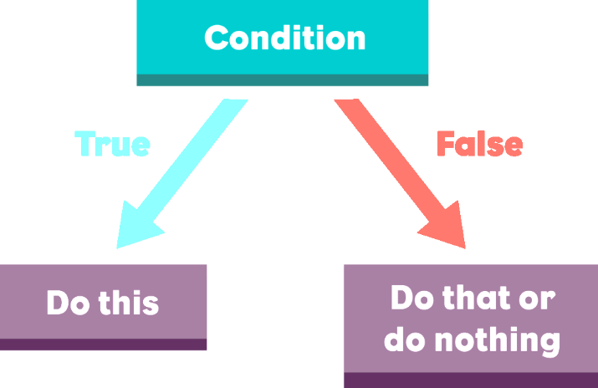
The If-else Statement
Implementing Control-Flow Logic

Slide 22
The If Statement
The simplest conditional statement
Test for a condition
Example: Take as an input a grade and check if the student has passed the exam (grade >= 3.00)
double grade = Double.parseDouble(sc.nextLine());
if (grade >= 3.00) {
System.out.println("Passed!");
}
In Java the opening bracket stays on the same line

Slide 23
The If-else Statement
Executes one branch if the condition is true and another, if it is false
Example: Upgrade the last example, so it prints "Failed!", if the mark is lower than 3.00:
if (grade >= 3.00) {
System.out.println("Passed!");
} else {
// TODO: Print the message
}
The else keyword stays on a new line

Slide 24
Problem: I Will Be Back in 30 Minutes
Write a program that reads hours and minutes from the console and calculates the time after 30 minutes
The hours and the minutes come on separate lines
Example:
1
46
0
01
23
59
2:16
0:31
0:29
11
08
12
49
11
32
11:38
13:19
12:02

Slide 25
Solution: I Will Be Back in 30 Minutes (1)
int hours = Integer.parseInt(sc.nextLine());
int minutes = Integer.parseInt(sc.nextLine()) + 30;
if (minutes > 59) {
hours += 1;
minutes -= 60;
}
// Continue on the next slide

Slide 26
Solution: I Will Be Back in 30 Minutes (2)
if (hours > 23) {
hours = 0;
}
if (minutes < 10) {
System.out.printf("%d:%02d%n", hours, minutes);
} else {
System.out.printf("%d:%d", hours, minutes);
}
%n goes on the next line

Slide 27
The Switch-Case Statement
Simplified If-else-if-else

Slide 28
The Switch-case Statement
Works as sequence of if-else statements
Example: read input a number and print its corresponding month:
int month = Integer.parseInt(sc.nextLine());
switch (month) {
case 1: System.out.println("January"); break;
case 2: System.out.println("February"); break;
// TODO: Add the other cases
default: System.out.println("Error!"); break;
}
Check your solution here: https://judge.softuni.bg/Contests/1190/

Slide 29

Problem: Foreign Languages
By given country print its typical language:
English -> England, USA
Spanish -> Spain, Argentina, Mexico
other -> unknown
England
English
Spain
Spanish

Slide 30
Solution: Foreign Languages
//TODO: Read the input
switch (country) {
case "USA":
case "England": System.out.println("English"); break;
case "Spain":
case "Argentina":
case "Mexico": System.out.println("Spanish"); break;
default: System.out.println("unknown"); break;
}

Slide 31
Logical Operators
&&
Writing More Complex Conditions

Slide 32
Logical Operators
Logical operators give us the ability to write multiple conditions in one if statement
They return a boolean value and compare boolean values
Operator | Notation in Java | Example
Logical NOT | ! | !false -> true
Logical AND | && | true && false -> false
Logical OR | || | true || false -> true

Slide 33
Problem: Theatre Promotions
A theatre has the following ticket prices according to the age of the visitor and the type of day. If the age is < 0 or > 122, print "Error!":
Day / Age | 0 <= age <= 18 | 18 < age <= 64 | 64 < age <= 122
Weekday | 12$ | 18$ | 12$
Weekend | 15$ | 20$ | 15$
Holiday | 5$ | 12$ | 10$
Weekday
42
Holiday
-12
18$
Error!

Slide 34
Solution: Theatre Promotions (1)
String day = sc.nextLine().toLowerCase();
int age = Integer.parseInt(sc.nextLine());
int price = 0;
if (day.equals("weekday")) {
if ((age >= 0 && age <= 18) || (age > 64 && age <= 122)) {
price = 12;
}
// TODO: Add else statement for the other group
}
// Continue…

Slide 35
Solution: Theatre Promotions (2)
else if (day.equals("weekend")) {
if ((age >= 0 && age <= 18) || (age > 64 && age <= 122)) {
price = 15;
} else if (age > 18 && age <= 64) {
price = 20;
}
} // Continue…

Slide 36
Solution: Theatre Promotions (3)
else if (day.equals("holiday")){
if (age >= 0 && age <= 18)
price = 5;
// TODO: Add the statements for the other cases
}
if (price != 0)
System.out.println(price + "$");
else
System.out.println("Error!");

Slide 37

Loops
Code Block Repetition

Slide 38
Loop: Definition
A loop is a control statement that repeats the execution of a block of statements. The loop can:
for loop
Execute a code block a fixed number of times
while and do…while
Execute a code block while a given condition returns true

Slide 39

For-Loops
Managing the Count of the Iteration

Slide 40
For-Loops
The for loop executes statements a fixed number of times:
Initial value
End value
Increment
for (int i = 1; i <= 10; i++) {
System.out.println("i = " + i);
}
Loop body
The bracket is again on the same line
Executed at each iteration

Slide 41

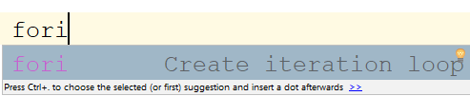
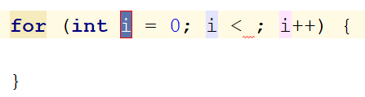
Example: Divisible by 3
Print the numbers from 1 to 100, that are divisible by 3
You can use "fori" live template in Intellij
for (int i = 3; i <= 100; i += 3) {
System.out.println(i);
}
Push [Tab] twice

Slide 42
Problem: Sum of Odd Numbers
Write a program to print the first n odd numbers and their sum
1
3
5
7
9
Sum: 25
1
3
5
Sum: 9
5
3

Slide 43
Solution: Sum of Odd Numbers
int n = Integer.parseInt(sc.nextLine());
int sum = 0;
for (int i = 1; i <= n; i++) {
System.out.println(2 * i - 1);
sum += 2 * i - 1;
}
System.out.printf("Sum: %d", sum);

Slide 44

While Loops
Iterations While a Condition is True

Slide 45
While Loops
Executes commands while the condition is true:
Initial value
Condition
int n = 1;
while (n <= 10) {
System.out.println(n);
n++;
}
Loop body
Increment the counter

Slide 46
Problem: Multiplication Table
Print a table holding number*1, number*2, …, number*10
int number = Integer.parseInt(sc.nextLine());
int times = 1;
while (times <= 10) {
System.out.printf("%d X %d = %d%n",
number, times, number * times);
times++;
}

Slide 47

Do…While Loop
Execute a Piece of Code One or More Times

Slide 48
Do ... While Loop
Similar to the while loop, but always executes at least once:
Initial value
int i = 1;
do {
System.out.println(i);
i++;
} while (i <= 10);
Loop body
Increment the counter
Condition

Slide 49
Problem: Multiplication Table 2.0
Upgrade your program and take the initial times from the console
int number = Integer.parseInt(sc.nextLine());
int times = Integer.parseInt(sc.nextLine());
do {
System.out.printf("%d X %d = %d%n",
number, times, number * times);
times++;
} while (times <= 10);

Slide 50

Debugging the Code
Using the InteliJ Debugger

Slide 51

Debugging the Code
The process of debugging application includes:
Spotting an error
Finding the lines of code that cause the error
Fixing the error in the code
Testing to check if the error is gone and no new errors are introduced
Iterative and continuous process

Slide 52
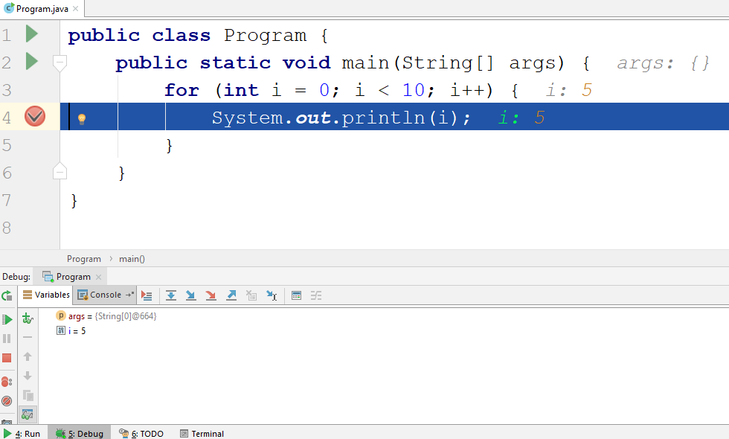
Debugging in Intellij
Intellij has a built-in debugger
It provides:
Breakpoints
Ability to trace the code execution
Ability to inspect variables at runtime

Slide 53
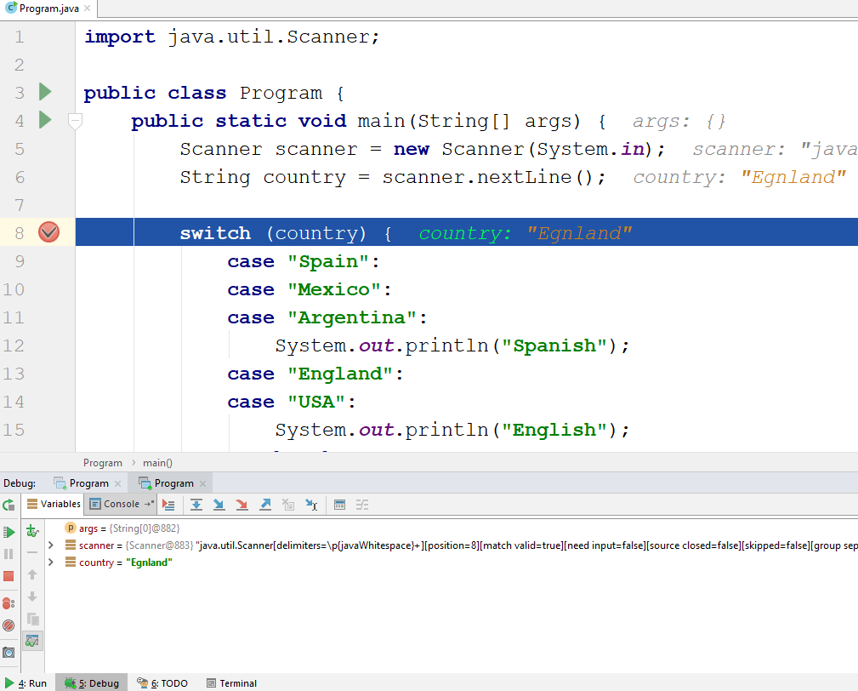
Using the Debugger in Intellij
Start without Debugger: [Ctrl+Shift+F10]
Toggle a breakpoint: [Ctrl+F8]
Start with the Debugger: [Alt+Shift+F9]
Trace the program: [F8]
Conditional breakpoints

Slide 54
Problem: Find and Fix the Bugs in the Code
A program aims to print the first n odd numbers and their sum
10
Scanner sc = new Scanner(System.in);
int n = Integer.parseInt(sc.nextLine());
int sum = 1;
for (int i = 0; i <= n; i++) {
System.out.print(2 * i + 1);
sum += 2 * i;
}
System.out.printf("Sum: %d%n", sum);

Slide 55

Summary
Declaring Variables
Reading from / Printing to the Console
Conditional Statements allow implementing programming logic
Loops repeat code block multiple times
Using the debugger
…
…
…

Slide 56
Questions?
Notes:
56

Slide 57












SoftUni Diamond Partners

Slide 58


Educational Partners

Slide 59
Trainings @ Software University (SoftUni)
Software University – High-Quality Education, Profession and Job for Software Developers
softuni.bg, about.softuni.bg
Software University Foundation
softuni.foundation
Software University @ Facebook
facebook.com/SoftwareUniversity
Software University Forums
forum.softuni.bg
Notes:
59

Slide 60

License
This course (slides, examples, demos, exercises, homework, documents, videos and other assets) is copyrighted content
Unauthorized copy, reproduction or use is illegal
© SoftUni – https://about.softuni.bg/
© Software University – https://softuni.bg
Notes:
60

